Slide 1
Prioritizing Tasks
Dennis Rendon & Mehrdad Fakhar

Slide 2
Ishikawa
Univesity/School
Professional Clubs
Business/Work
Enrollment Deadline
Membership fee(s)
Work Schedule
Assignments/HW/Projects Deadline
Meeting Schedule
Report Deadline(s)
Exam-Schedule
Meeting(s)
Unable to Prioritize Tasks
Kids School Schedule
Travel
Gatherings & Parties
Bills & other Payments
Meeting Schedule
Birthdays
Doctor Appointment(s)
Social/Clubs
Family
Miscellaneous

Slide 3
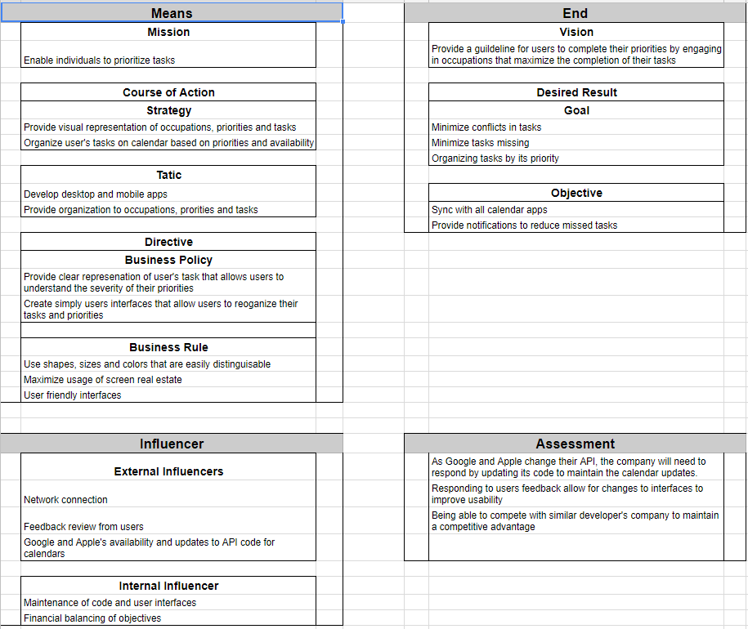
BMM

Slide 4
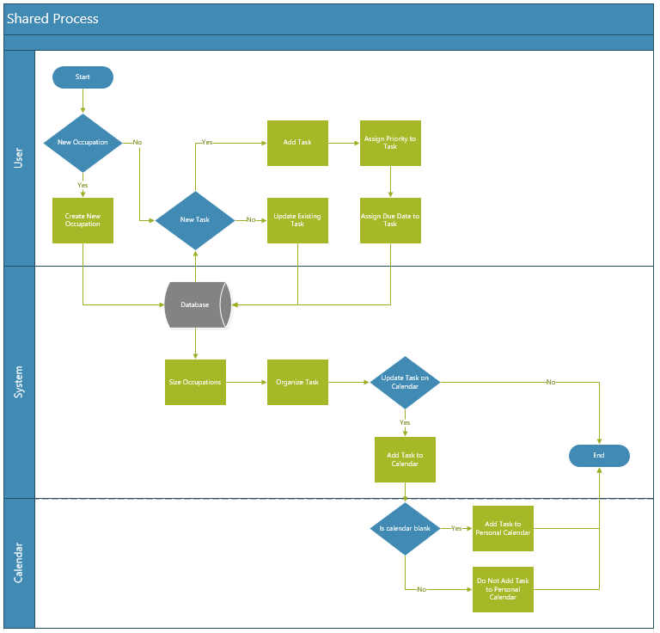
BPMN

Slide 5
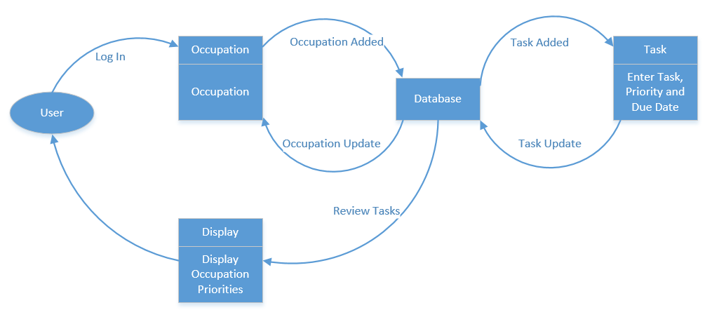
DFD

Slide 6
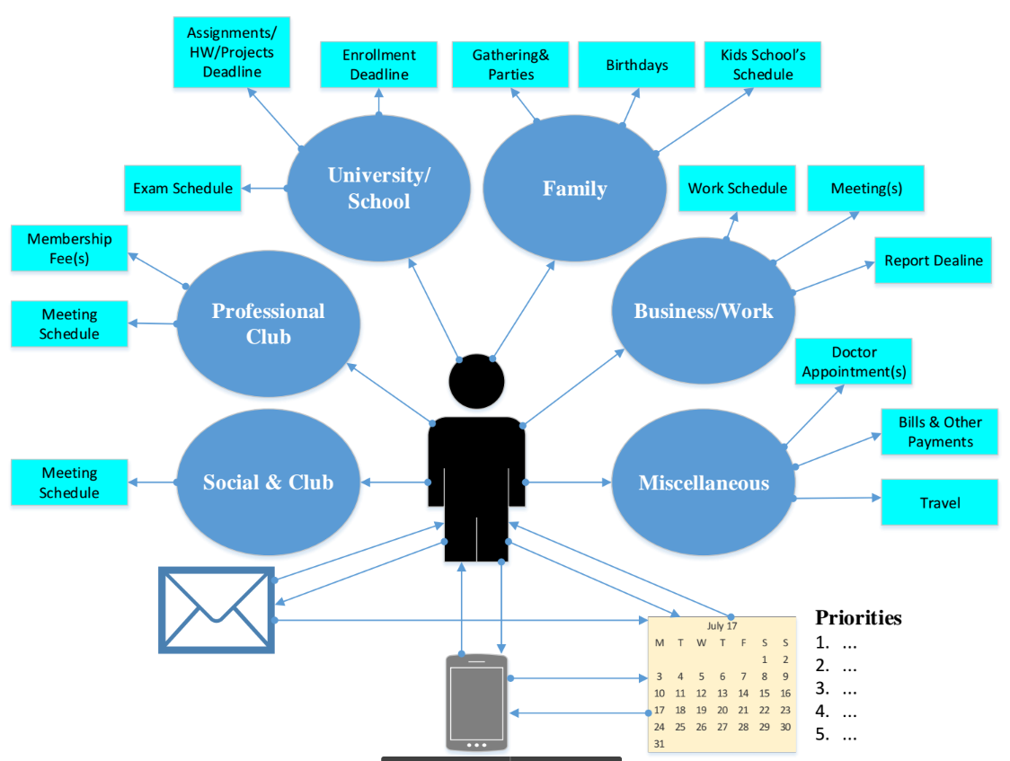
Org Chart
& UI
Notes:
The student interacts with many different entities that take time away from studies. Each entities causes a different level of distractions. Some are more important and have a higher priority to the student. The student uses the app and connects their study and assignments to their priorities. The student adds the priorities to their calendars to help reduce the chance of missing the assignment.

Slide 7
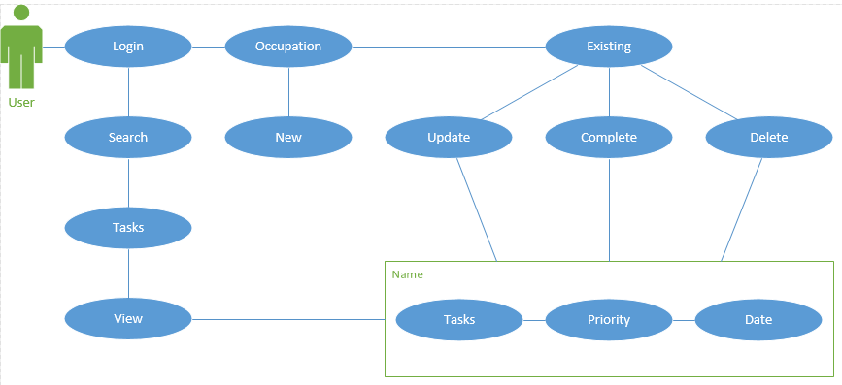
Use Case
Notes:
The user logs into the app on her phone. Once they login, they can either search for current tasks or create a new one. To create a new task, they must decide if it’s a new or an existing occupation.

Slide 8
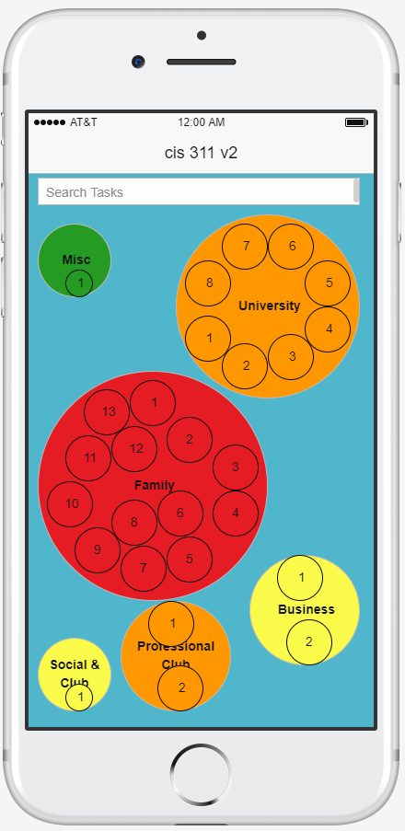
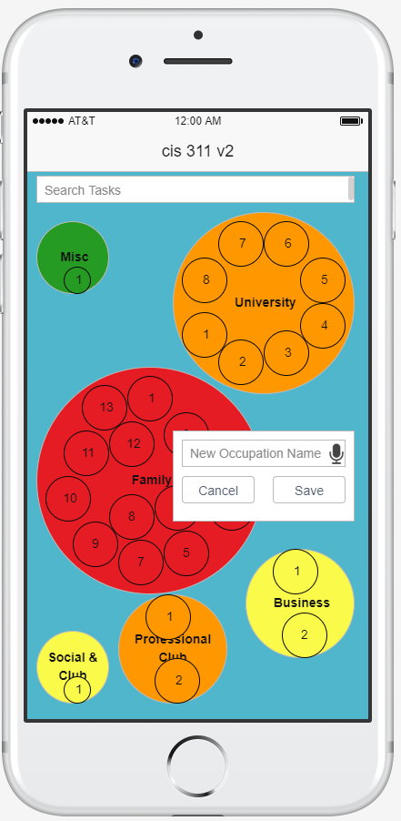
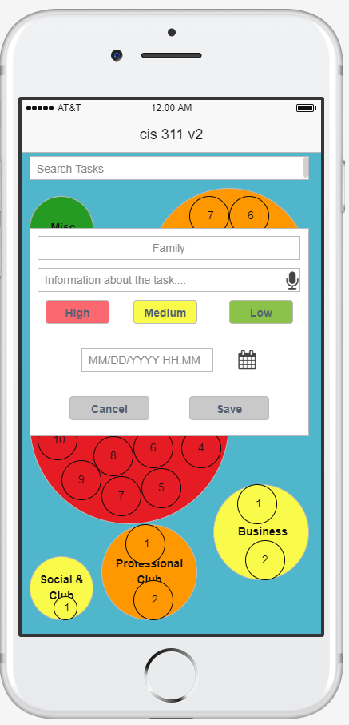
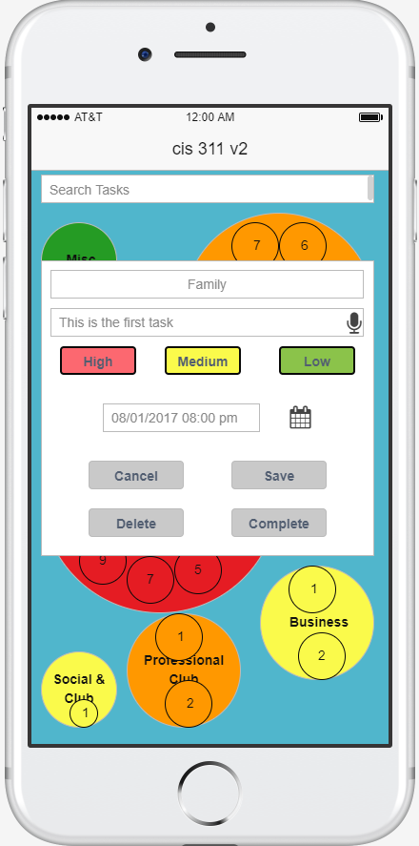
Wireframe

Slide 9
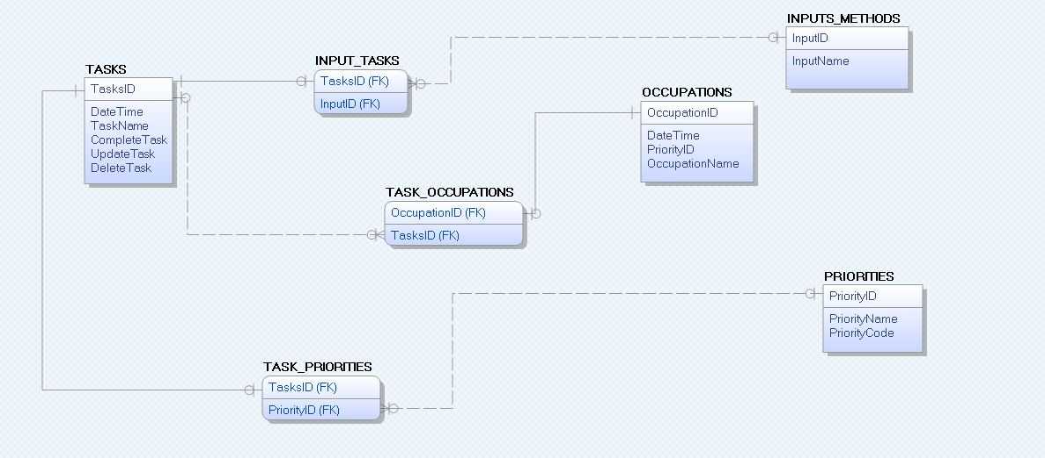
ERD

Slide 10
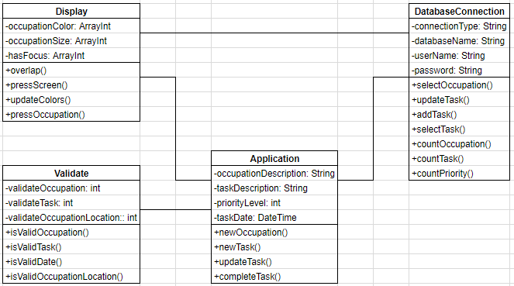
Class Diagram

Slide 11
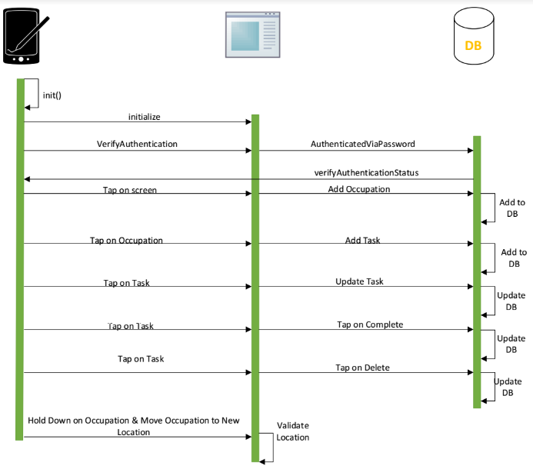
Sequence
Diagram

Slide 12
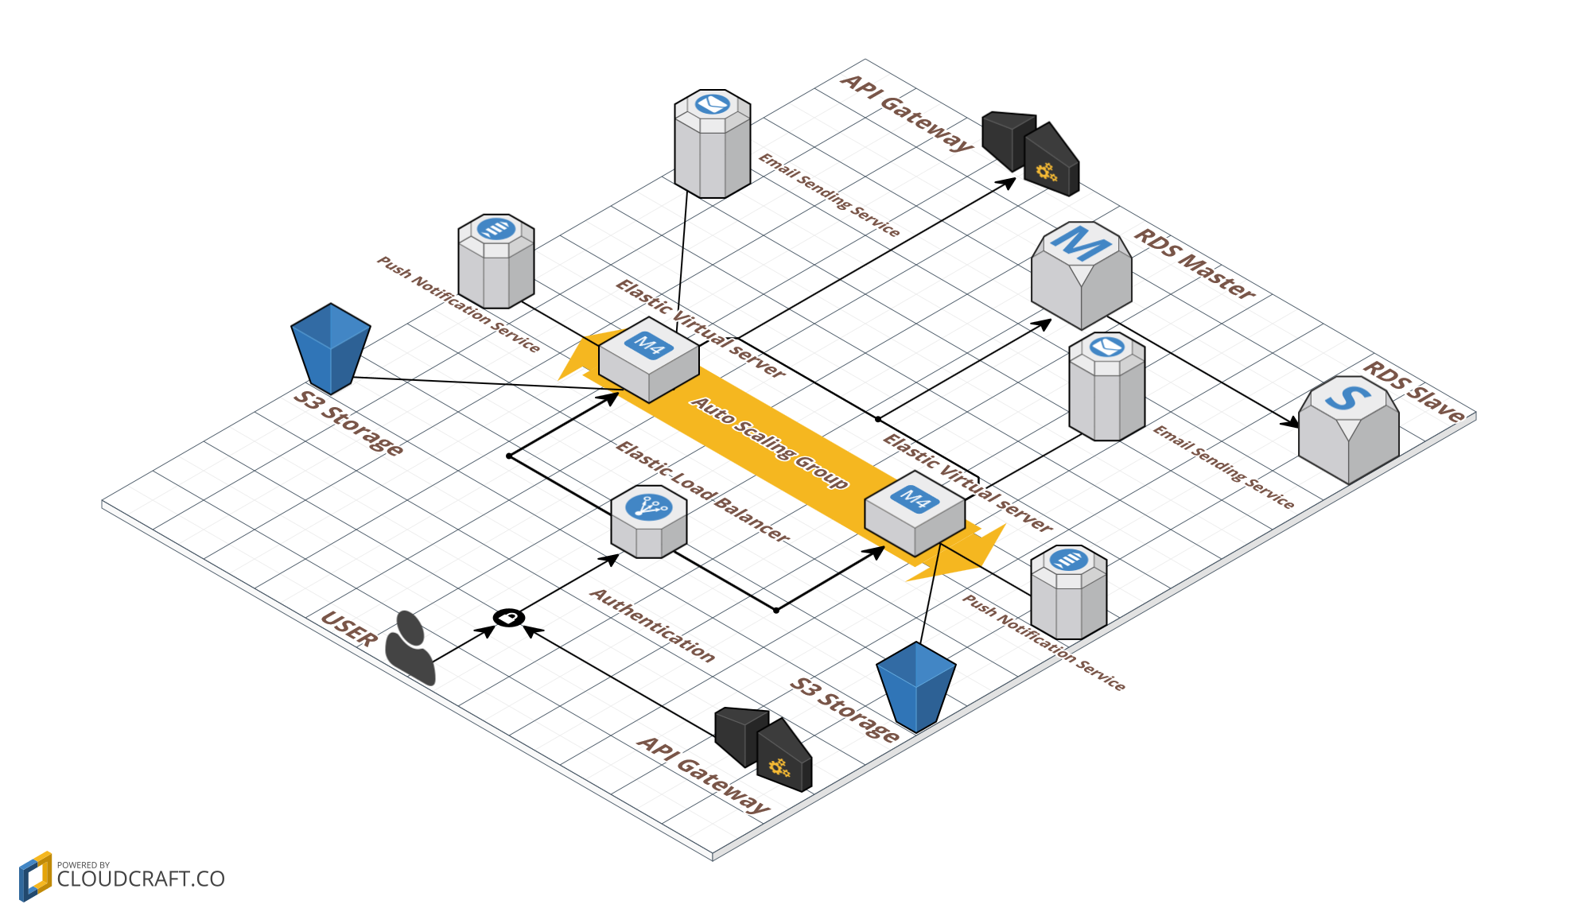
Network Diagram

Slide 13
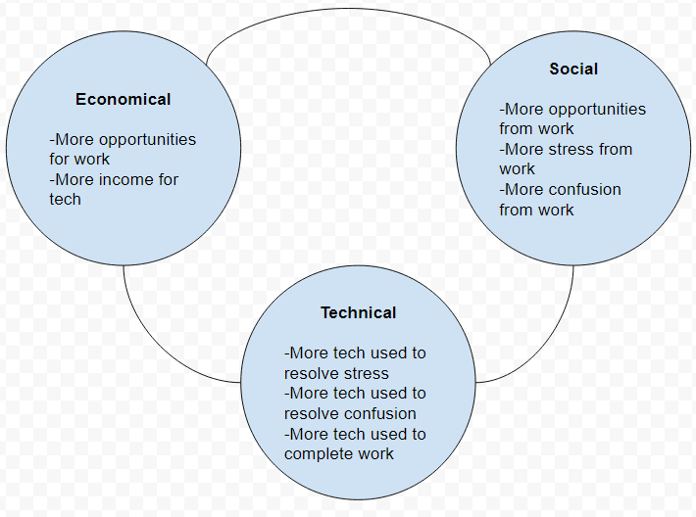
Pestle

Slide 14
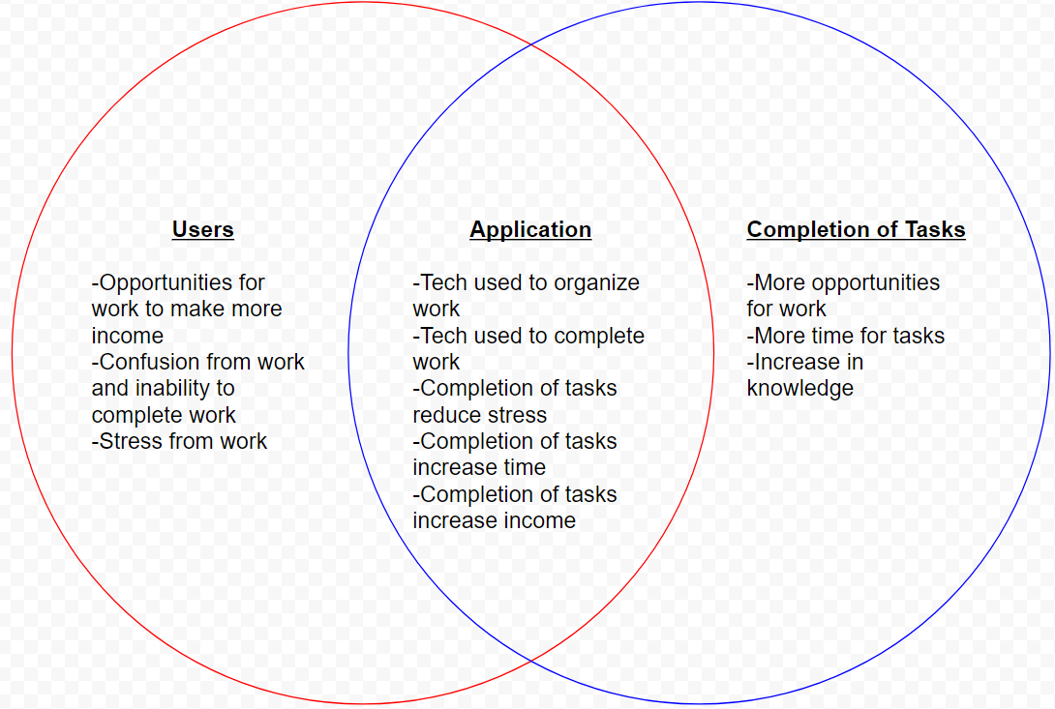
Venn Diagram

Slide 15
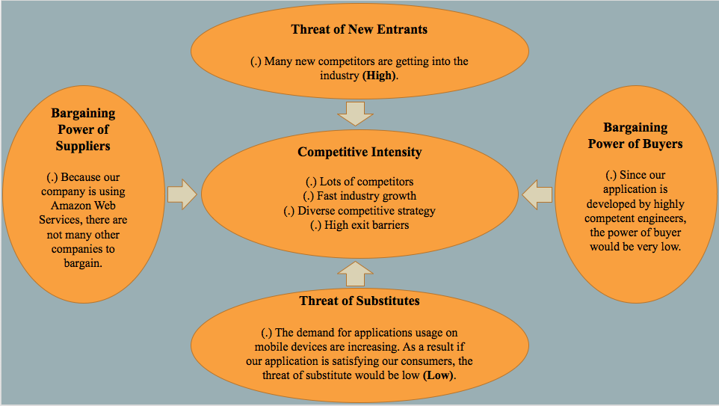
Michael Porter’s Five Forces

Slide 16
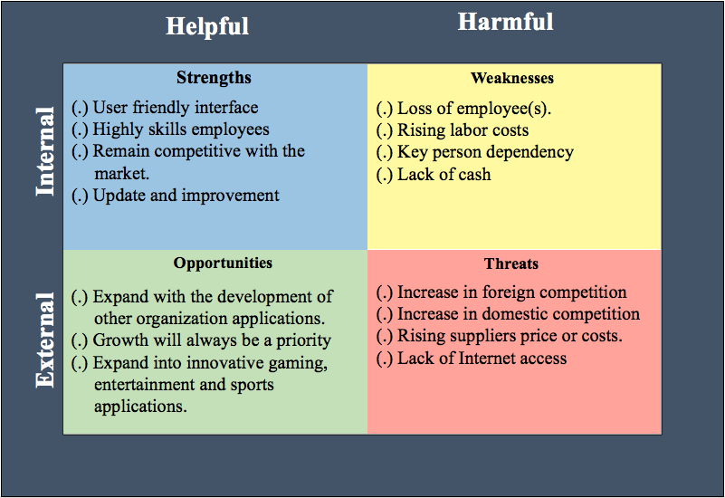
SWOT

Slide 17
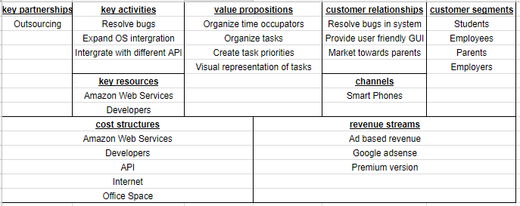
Business Model Canvas

Slide 18
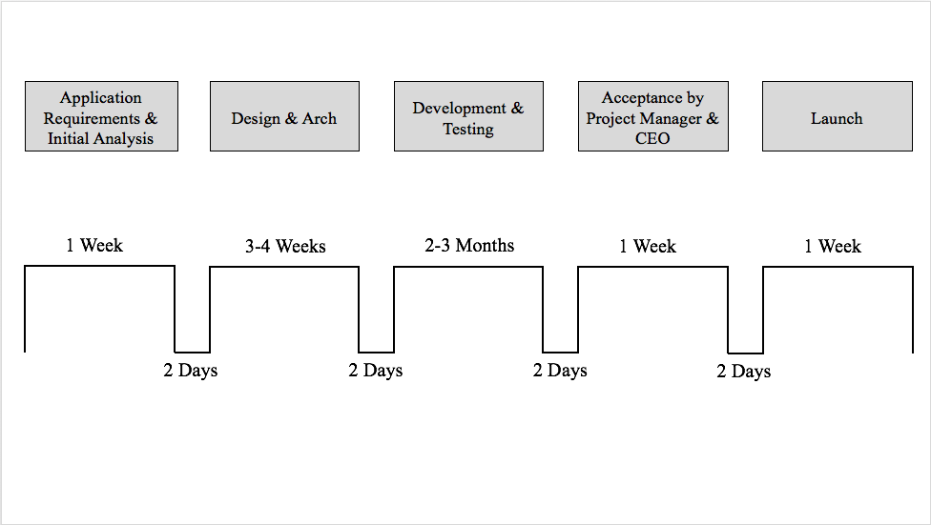
Value Stream Analysis

